Slide 1
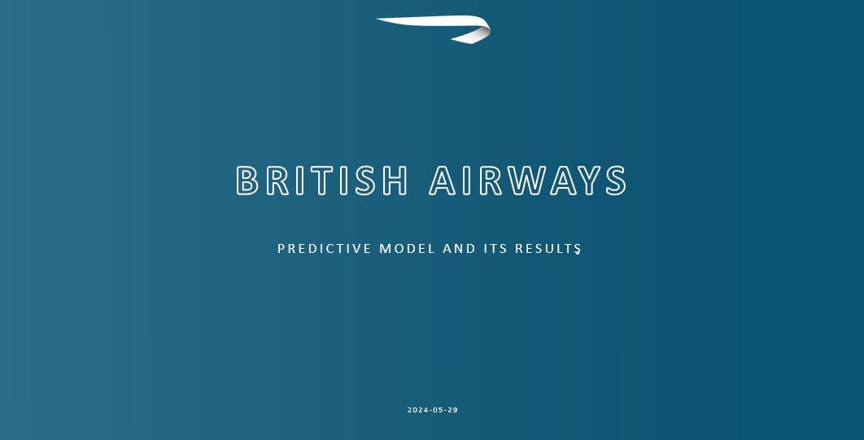
TITLE

Slide 2

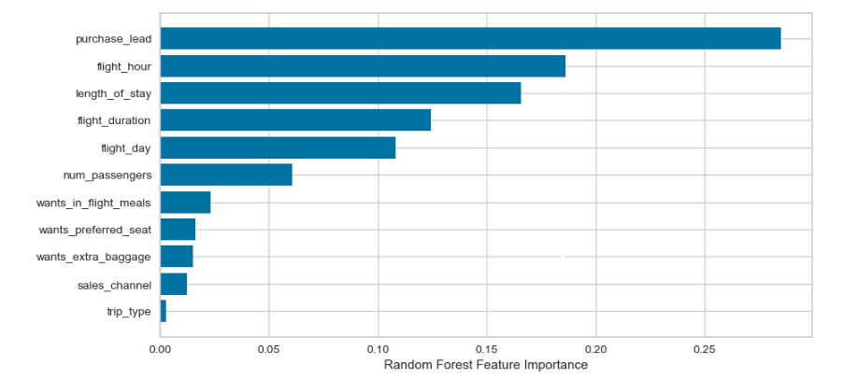
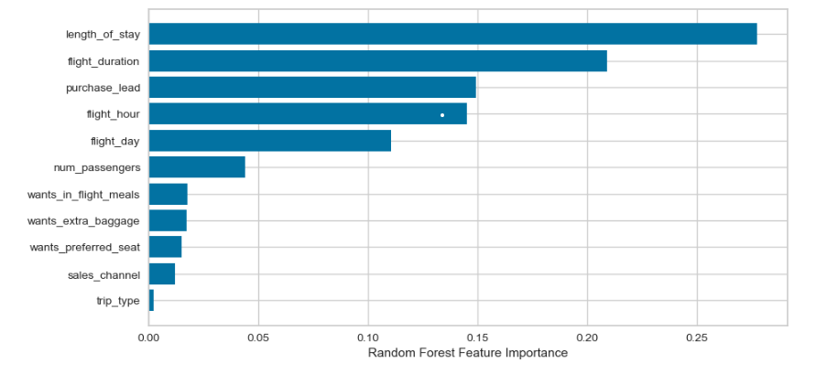
PREDICTIVE MODELLING RESULTS
Accuracy
90%
Feature Importance Under Imbalanced Dataset
Accuracy of the model predicting successful or incomplete booking is
Precision
94%
Recall
84%
Will be predicted as actually completed bookings out of all successfully bookings.
Chance of predicting true successful bookings.
Feature Importance Under balanced Dataset
F1-Score
89%
The above metrics are on the balanced dataset. The dataset given is highly imbalanced. Imbalance dataset drives higher accuracy but it does not accurately predict successful bookings. The dataset was balanced with artificially introduced 35044 data points by SMOTE

